Slide 1
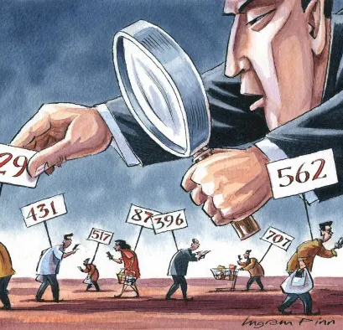
Social Scoring Systems
Carraro Marco
Debole Nicola
Stefan Massimo

Slide 2
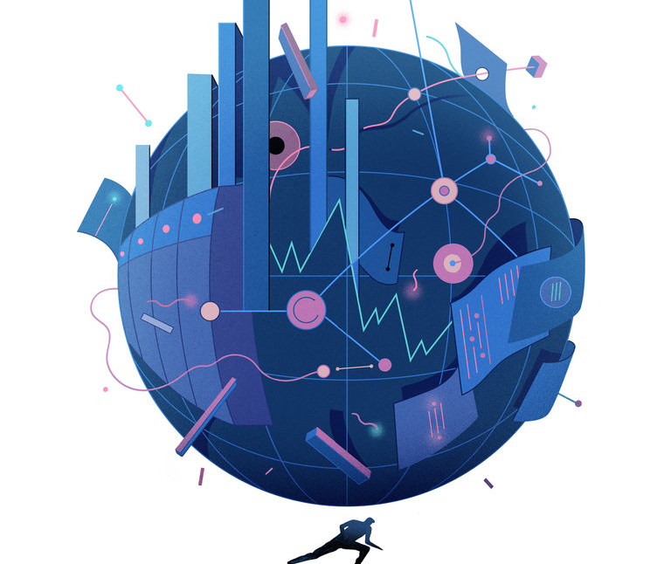
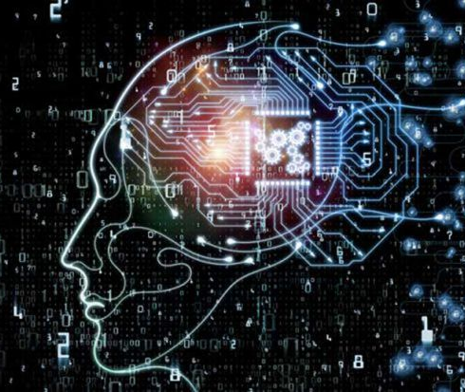
Index
Introduction to Social Scoring
Social Scoring: Goals and prohibited practices
Social Scoring: State of the art
AIA: High-risk AI systems
Credit score
Legal principles
Conclusion

Slide 3
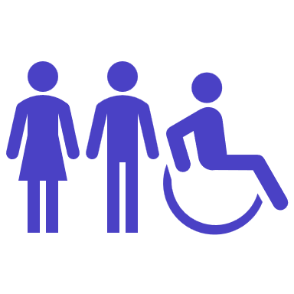



📊 Social Scoring 📊
What is it?
Composition
It is an umbrella term intended to define all those practices used to assign a particular score to a section of the population, through tracking systems and AI.
Population
Authority
Ranking & evaluation System
Advantages & Disadvantages

Slide 4
📊 Social Scoring 📊
What does it affect?
Applied contexts
The access to and enjoyment of certain essential private and public services and benefits necessary for people to fully participate in society or to improve one’s standard of living.
Credit and financial reliability of a customer (as in Chinese SCS)
Determine subjects which should be targeted for access, eligibility, suspicion or exclusion
Transformation of people into automation and statistical analysis
Surveillance practices (e.g., border control using emotional AI)
⚠️ At the current state restrictions only apply for public administrations and NOT to private entities
Notes:
La parte di sinistra sarebbe di Nick – Intro chap 3

Slide 5
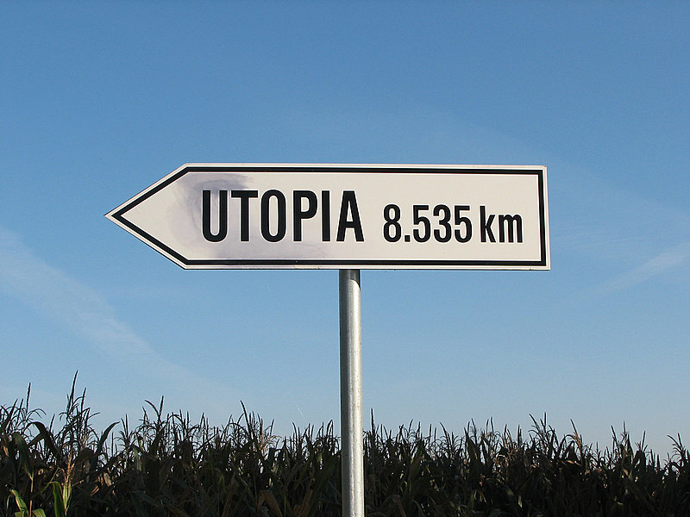

🎯 Social Scoring - Goals 🎯
Utopia
Reality
Redistribute resources
Encourage social morality
Enforce social management
…
Limited freedom of speech
Privacy risks
Internalization of the government wills
…

Slide 6
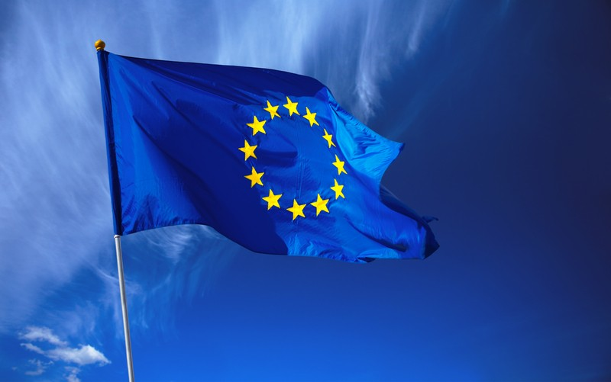
⭐ Social Scoring: the EU values ⭐
What does EU think about it? 🤔
The Union has classified the most of this kind of system as "high-risk". They need under all circumstances the supervision of a physical person.
What are the proposals? 🤌🏻
Social Scoring systems classified as "contravening Union values" and are going to be banned.
Prohibit AI systems that cause harm to people manipulating their behavior, opinions or decisions.
Particular exception ✅
The authorities are fighting serious crime, but limited in time and space

Slide 7

🌍 State of the art – Countries 🌍
United Kingdom – Live facial recognition
The UK government revealed that they would be using Live Facial Recognition (LFR) software on the streets of London in order to find police suspects
Once a person is scanned:
If he/she is not present into the database → data removed in seconds
Otherwise → an alert is sent to the nearest officers
✅ Pros ✅
Huge help in identifying suspects
Less police on the streets
Less random interrogations
❌ Cons ❌
Inadequate transparency
Inadequate accountability measures
Dangerous in the wrong hands
⚔️

Slide 8
🌍 State of the art – Countries 🌍
United Kingdom – Health system
In 2021, Boris Johnson tried to introduce a health social-credit system to reduce obesity and improve bodily health among the British public.
It would have monitored family supermarket spending, rewarding those who:
Reduced their calorie intake
Bought more fruit and vegetables
✅ Pros ✅
Reduce obesity rate
Alleviate the pressure on the UK’s health system
❌ Cons ❌
One’s body – One’s health
High invasion of privacy
⚔️

Slide 9

🌍 State of the art – Countries 🌍
Italy (Bologna)
The Smart Citizen Wallet aims to reward people for “virtuous behavior” such as:
Recycling
Using public transport
Managing energy well
Not getting fined
✅ Pros ✅
Reward good behavior
Benefits with discounts and free cultural activities
❌ Cons ❌
Circumvent the “privacy problem”
Punish who doesn’t download the app by withdrawal of benefits
⚔️

Slide 10

🌍 State of the art – Countries 🌍
China
The Chinese government introduced the Plant for the Establishment of the Social Credit system to promote:
Government performance
Credit score
Social score
Judicial credibility
It introduces:
Red lists: obtain a “priority channel” for administrative approvals
Black lists: unfair strict supervision

Slide 11
🌍 State of the art – Countries 🌍
China - Process
Aggregate different data warehouses
Transform heterogeneous qualities to common metrics
Behavioral data function as indicator to determine point earns and losses
Numerical scores are converted into ordinal levels of measurements
✅ Pros ✅
Increase attention to honest social behavior
“Improve” quality of life
❌ Cons ❌
Undermine the legitimate rights and freedoms of individuals
May become a tool for mass state surveillance
⚔️

Slide 12

🏬 State of the art – Companies 🏬
Microsoft
Microsoft introduced a quality score and a productivity score inside the Microsoft ecosystem.
The productivity score focuses on:
People experiences (communication, mobility, meetings, …)
Technology experiences (endpoint analytics, network connectivity, …)
Special reports
✅ Not invasive as others, but rather insight of overall productivity and discover the critical sectors

Slide 13

🏬 State of the art – Companies 🏬
WeChat
One of its services is the deposit-free rental services.
It permits only to those that have a certain credit (WeChat Payments Score) to utilize this service.
To assign each score it measures multiple user data attributes, like:
Buying behavior
Contract fulfillment
❌ it considers a user’s purchasing and his/her contract-fulfillment history, leading to privacy issues

Slide 14
❌ AIA - Prohibited practices ❌
What are the prohibited practices?
Consequences?
One of them is Social Scoring, namely the evaluation or classification of the trustworthiness of natural persons (over a certain period) based on:
their social behavior
predicted personal characteristics
Detrimental or unfavorable treatment of persons:
unrelated to the contexts in which the data was originally generated or collected
unjustified or disproportionate to their social behavior or its gravity
What article would prohibit them?
Article 5 of the AI Act (2021)

Slide 15
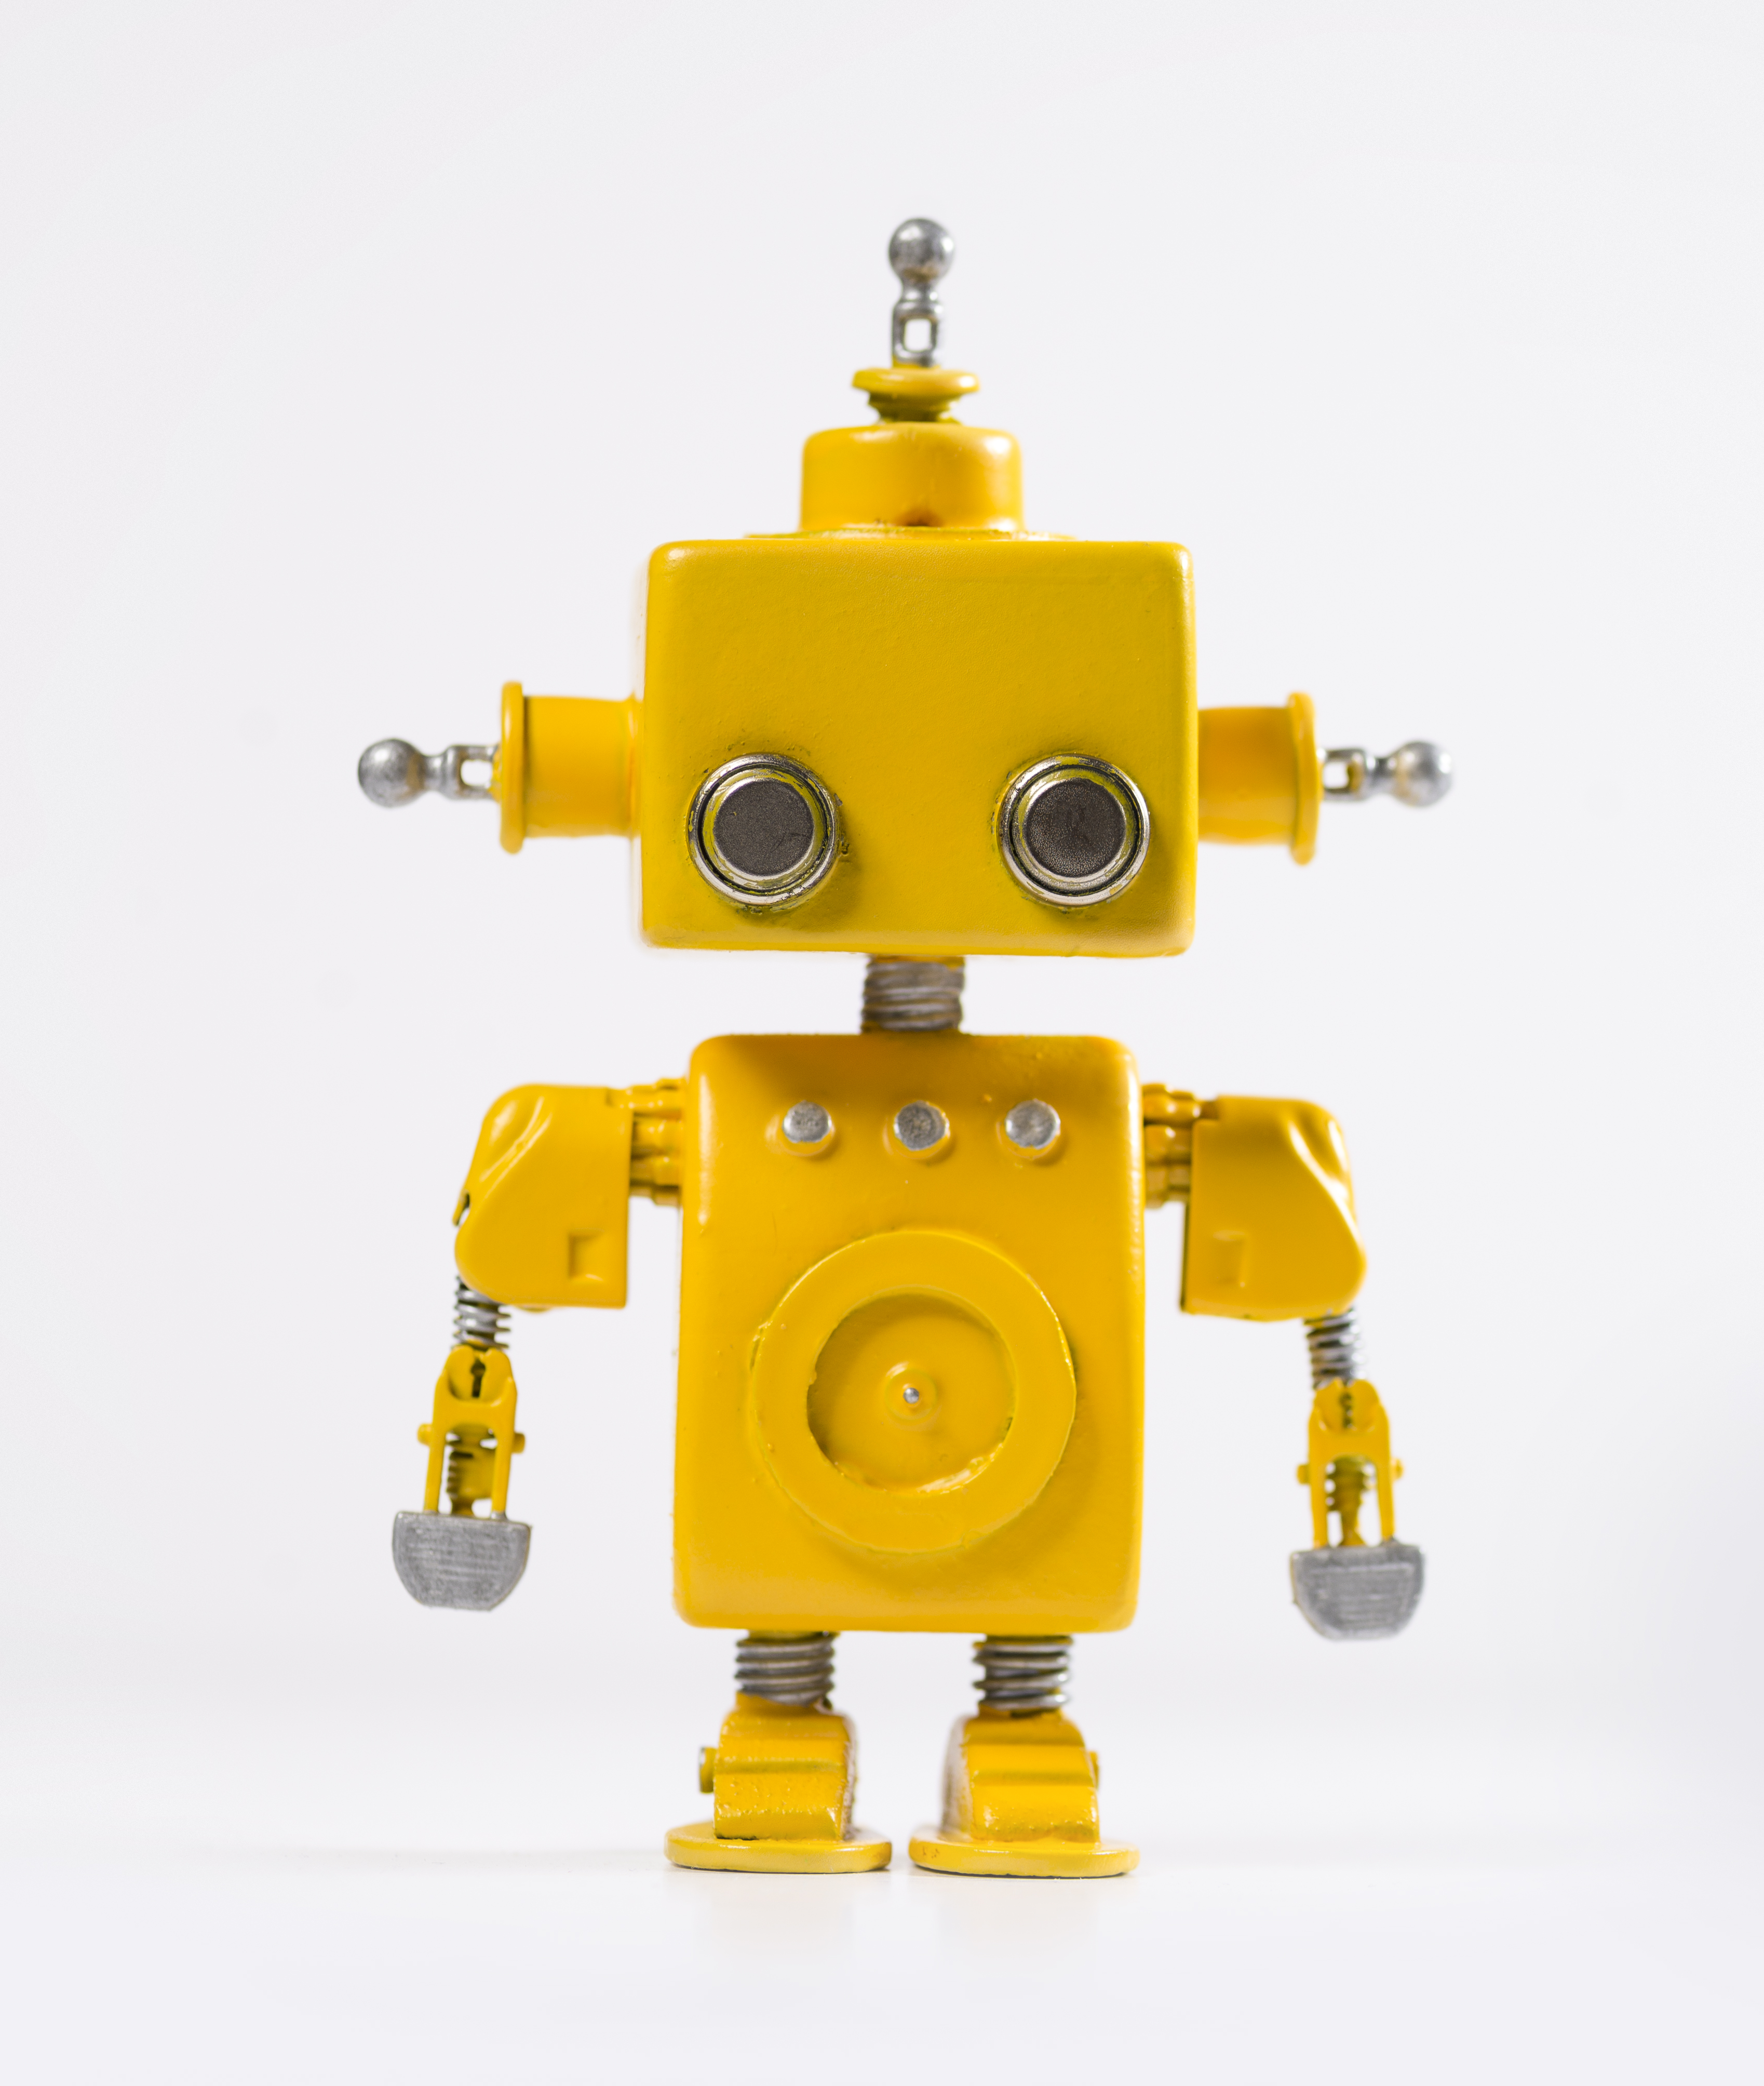
⚠️ AIA - High-risk AI systems ⚠️
AIs considered high-risk (in Annex III):
AIs that make decisions on:
promotion and termination of work-related contractual relationships
task allocation
monitoring
evaluation performance and behavior
AIs used by public authorities to evaluate the eligibility of natural persons for public assistance benefits and services, as well as to grant, reduce, revoke, or reclaim such benefits and services
AIs used to evaluate:
the creditworthiness of natural persons
establish their credit score (except for AI systems put into service by small scale providers for their own use)

Slide 16
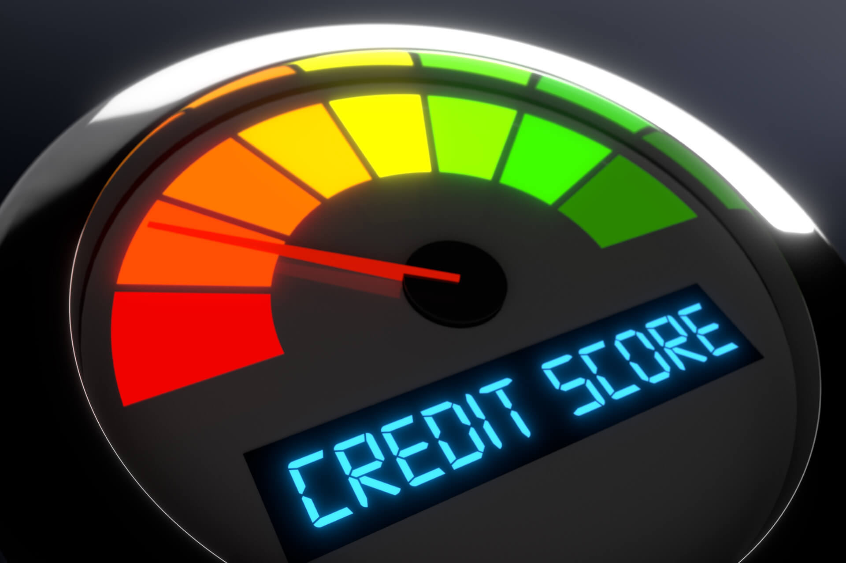
⚠️ AIA - High-risk AI systems ⚠️
Requirements for high-risk AI systems
Article 8 - Compliance with the requirements
Article 9 - Risk management system
Article 10 - Data and data governance
Article 11 - Technical documentation
Article 12 - Record-keeping
Article 13 - Transparency and provision of information to users
Article 14 - Human oversight
Article 15 - Accuracy, robustness and cybersecurity
Example: Credit score

Slide 17
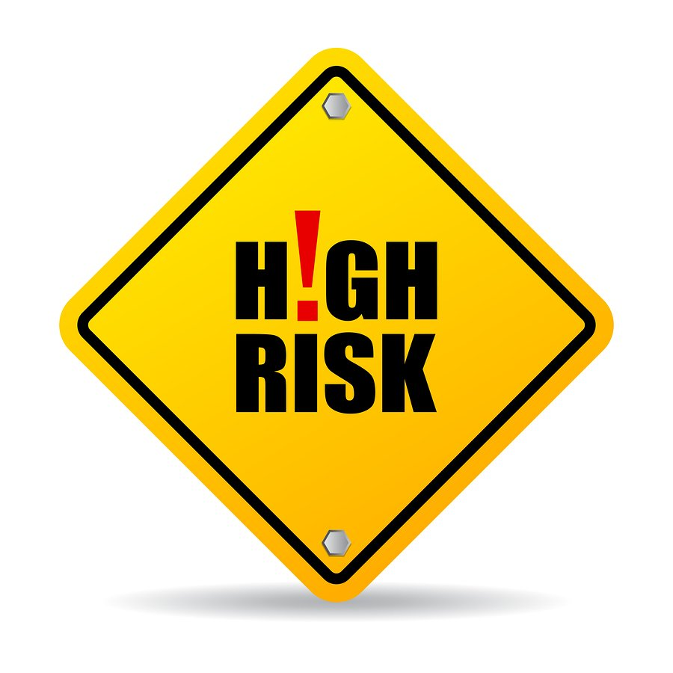
💳 Credit score 💳
Definition
AI systems used to evaluate the credit score, or creditworthiness of natural persons
Why considered high-risk?
They determine those persons’ access to:
financial resources
essential services such as housing, electricity, and telecommunication service
They need to withstand attacks such as:
Data breaches/poisoning
Adversarial examples
Exploits of the model due to intrinsic flaws

Slide 18




⚖️ Legal principles ⚖️
Right to medical care
Safeguard health as a fundamental right of the individual
Freedom and equality
- Article 25 Human Declaration of Human Rights
- Article 32 Italian Constitution
Right to privacy
Equality principle
Prohibition of discrimination
Freedom of expression
Data breaches occur daily even to big corporations
Principle of good administration
- Article 7,8 Charter of fundamental rights of the European Union
- Article 8 European Convention on Human Rights
- Article 1 Human Declaration of Human Rights
- Article 3 Italian Constitution
Public administrative offices shall ensure the efficiency and impartiality of the administration.
- Article 97 Italian Constitution

Slide 19
🏁 Conclusions 🏁
Tradeoffs
🧑🏻‍💻 AI Development
⚔️
Legal principles ⚖️
📢 Public authorities
⚔️
Private authorities 🏪
🧍🏻 Citizen Intrinsic nature
⚔️
Imposed Laws 📐
Our possible solution
❌️ "Theory of punishment" and penalization
✔️ Calibrated benefits to virtuous citizens

Slide 20

Thank you for your attention.
Carraro Marco
Debole Nicola
Stefan Massimo

